Slide 1
NYC Property Sales Analysis
A Springboard Data Science Capstone Project
By: Jimmy Cheng

Slide 2

Problem
Largest Metropolitan Area in the US
Largest City and one of the most desirable places to live in
How much does it cost to own a property here?
Can we use data to accurately predict NYC house prices with a 20% margin of error?

Slide 3
Data
NYC Department of Finance Annualized Sales data of 2022 – 2023
Data from 5 Boroughs – Manhattan, Brooklyn, Queens, Bronx and Staten Island
84391 Observations, 21 features including neighborhood, building type, square footage, sales data and other categorical and numerical features
TARGET FEATURE: SALE PRICE
Sale Price observations < $10000 were removed since the price is used as a placeholder instead of actual value
All N/A fields were replaced by Median value aggregated by Borough

Slide 4
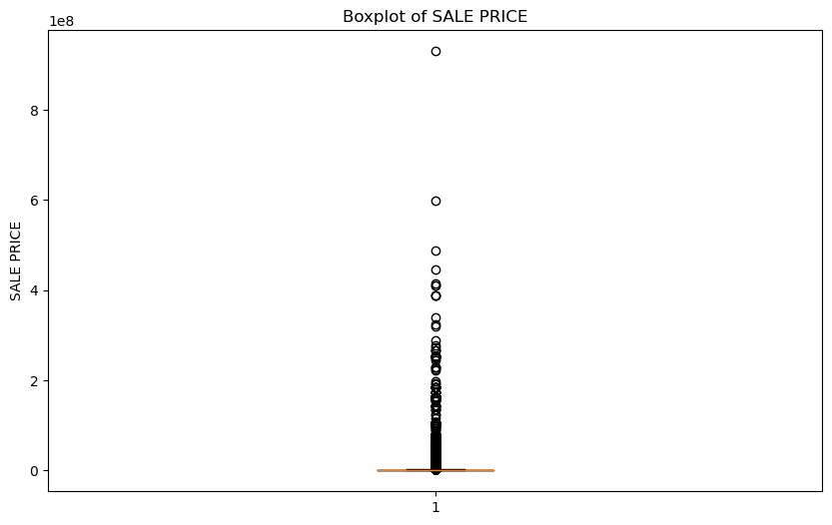
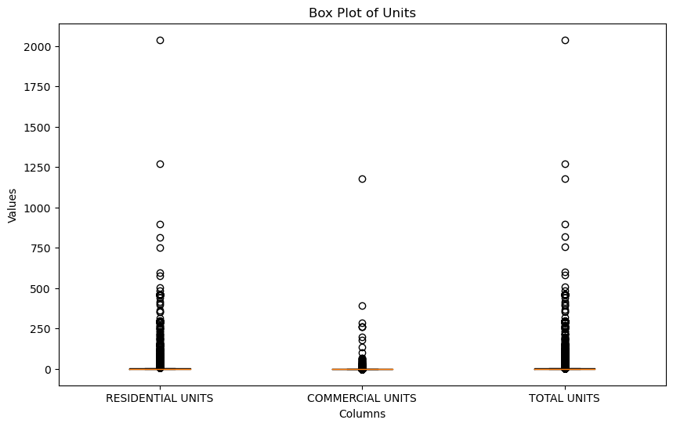
Data Outliers
Our data has too much outliers that skew the data! Many sale observations are for an entire building and not individual units.
I decided to set thresholds and completely drop those outliers since these observations are not the target of our analysis.
Total Units < 500
Sale Price < $10,000,000
200 < Gross Square Feet < 20,000
200 < Land Square Feet < 20,000

Slide 5
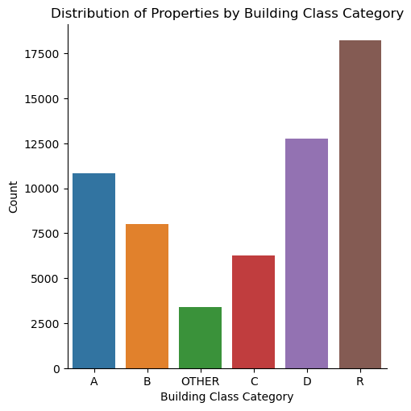
Exploratory Data Analysis – Categorical Features
What is the distribution of our data observations? Are we just predicting a single building type (condos)?
We have an even distribution among the top 5 building classes and all other building classes are aggregated into a new class called OTHER

Slide 6
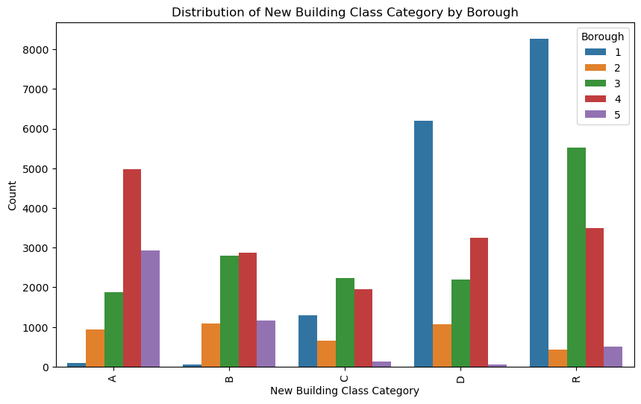
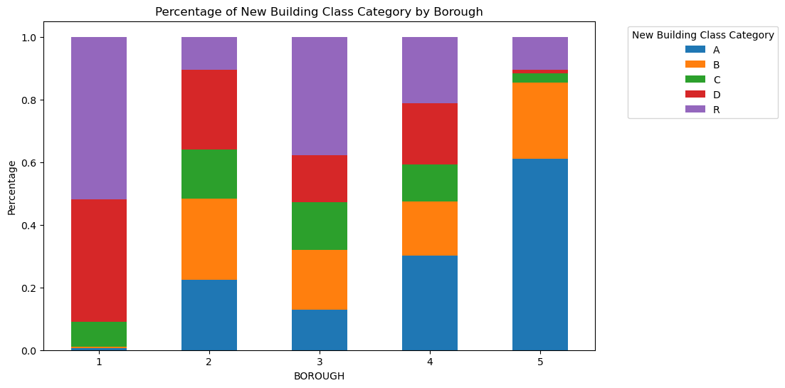
Where are our buildings located?

Slide 7
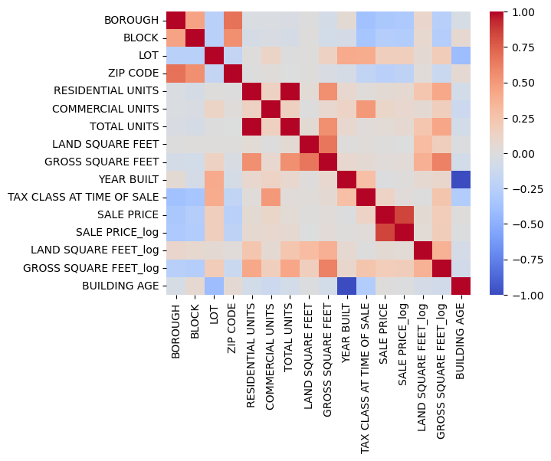
Exploratory Data Analysis – Numerical Features
What affects Sale Price?
Correlation Plot of numerical features
Address- Borough, Block, Zipcode
Area – Gross Square Feet

Slide 8
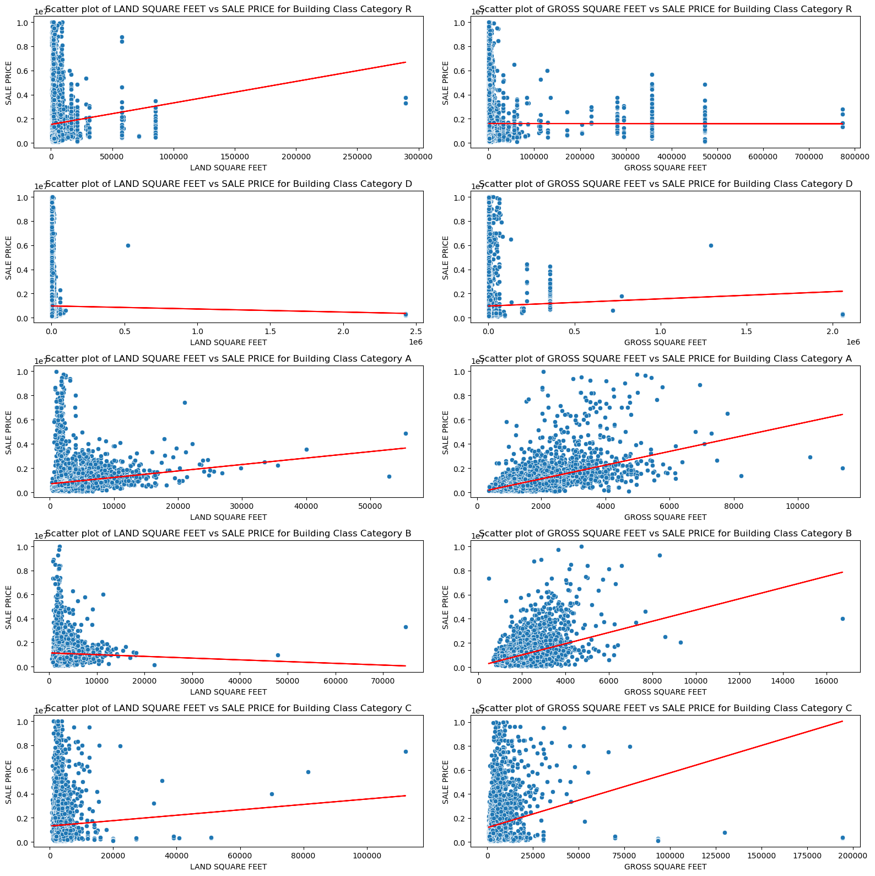
Exploratory Data Analysis – Numerical Features
Is there any pattern between sale price vs land square feet or gross square feet?
For Category A there seems to be a weak linear relationship between Gross Square Feet and Sale Price
No observable pattern / linear relationships

Slide 9
Preprocessing and Training Data Development
Label Encoding
One Hot Encoding
Standard Scalar
70/30 Train Test Split
K-fold cross validation (k = 5)
Model Metrics: RMSE, MAE, R-SQUARED, Residual Plots

Slide 10
Model Selection
Model | RMSE | MAE | R-SQUARED
Dummy Regressor | 1324072 | 812307 | -2.279e-05
Linear Regression | 1172347 | 687382 | 0.216
Polynomial Regression | 10142388696 | 80489371 | -58676848
Random Forest Regressor | 771417 | 390155 | 0.661
XGBoost Regressor | 804761 | 429233 | 0.631
KNN Regressor | 894564 | 456070 | 0.543
PCA + Linear Regression | 1263801 | 793221 | 0.0889

Slide 11
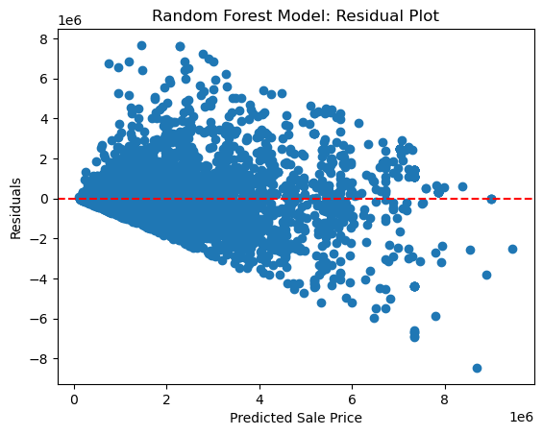
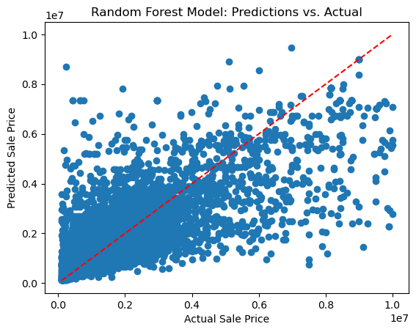
Random Forest Regressor

Slide 12
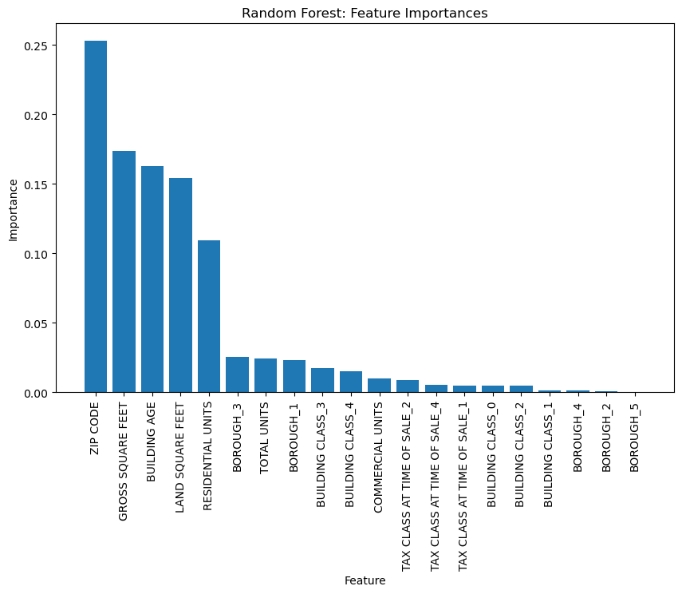
Random Forest Regressor
Most important features: Zip Code, Gross Square Feet, Building Age
However!! Look at our metrics and our residual plots. More can be done!

Slide 13
Residual Analysis
$390155 is too large of a residual for average home price of $1220000!
Determine threshold of Residual < $500000 and look at observations that fall outside the threshold limit vs observations within
What causes large residuals?

Slide 14
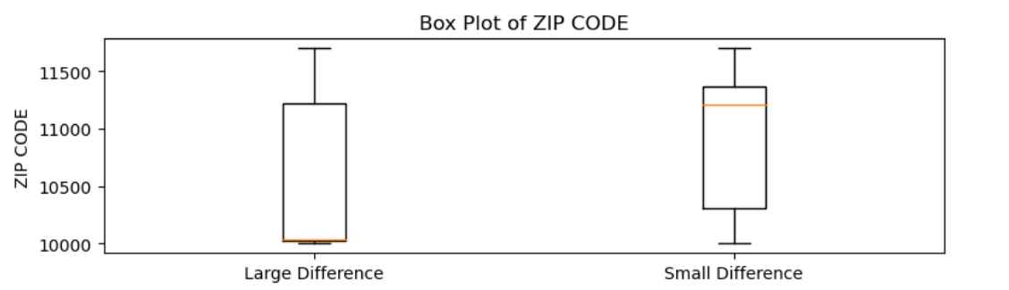
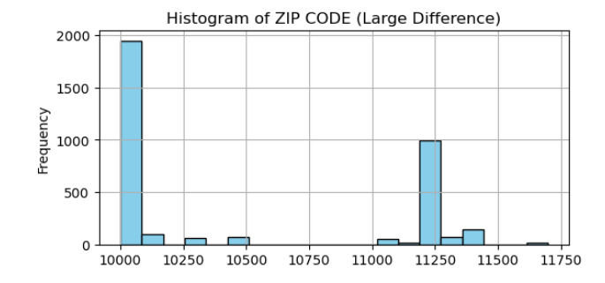
LOCATION LOCATION LOCATION!
Zip Code
10000 corresponds to areas in Manhattan and 11250 corresponds to areas in Brooklyn
46% of our predictions in Manhattan result in large residuals!
23% of our predictions in Brooklyn result in large residuals!

Slide 15
Rationale
Remove Manhattan and Brooklyn observations
Extrinsic premium not captured by model, it may be non-linear and varies over time.
Data insufficient to accurately predict prices
Maybe we require additional data such as rental yield, interest rates, mortgage rates, employment data, demographics?

Slide 16
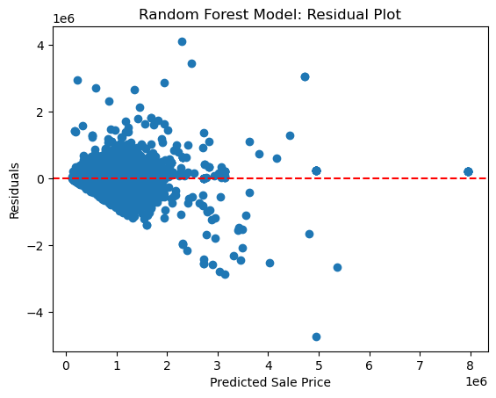
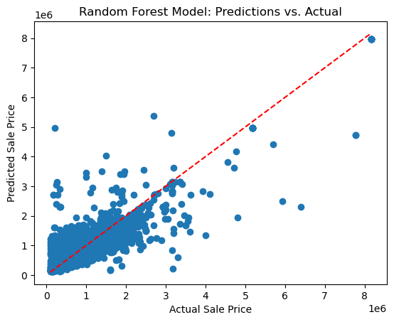
Revised Random Forest Regressor
RMSE | MAE | R-squared
289961 | 158457 | 0.743

Slide 17
Hyperparameter Tuning
RandomizedSearchCV
Root Mean Squared Error: 288290.6234495329
Mean Absolute Error: 157226.32305117117
R-squared: 0.7467326534983358
Best Hyperparameters:
n_estimators: 900
min_samples_split: 5
min_samples_leaf: 1
max_depth: 60
bootstrap: True

Slide 18
Conclusion
We have successfully built a Random Forest Regressor model to predict property sale prices of Queens, Bronx and Staten Island in the year of 2022
Error of margin is within 20%
If average price doesn’t change significantly over time, the model may be reused to predict future property sale prices.

